Slide 1
MOVIE INFORMATION DATABASE
Rohith Reddy Kasarla
Vinay Kumar Revanuru
Bilvani Veparala

Slide 2
DataSet
This Dataset contains information of various movies that are listed on IMDB websites
Has information of movies that are nominated for Oscar in various categories
Has the tags that viewers gave by watching the movies
Has the Reviews given by users on the movies
Tag scores that gives the relevance of each tag in data with the movie.
Has personal information of Cast and Crew of movies

Slide 3
Sources of Data
We obtained all the datasets from Kaggle ,here we are attaching all the links
IMDB Movies ,Netflix: https://www.kaggle.com/datasets/mirajshah07/netflix-dataset
Oscar Awards : : https://www.kaggle.com/datasets/dharmikdonga/academy-awards-dataset-oscars
Movie Tag dataset: Tag, Movie_tag_scores, Imdb_tmdb_connector, User_tag: https://www.kaggle.com/datasets/aigamer/movie-lens-dataset?select=tags.csv
Person_details : https://www.kaggle.com/datasets/komalkhetlani/imdb-dataset
Reviews : https://www.kaggle.com/datasets/nikosfragkis/imdb-320000-movie-reviews-sentiment-analysis

Slide 4
DataSet
Overall our normalized Data Base is 35 MB large
you can find this normalized data in our github repository
https://github.com/Rohithreddy86/Movies-Information-Database

Slide 5
ER Diagram

Slide 6
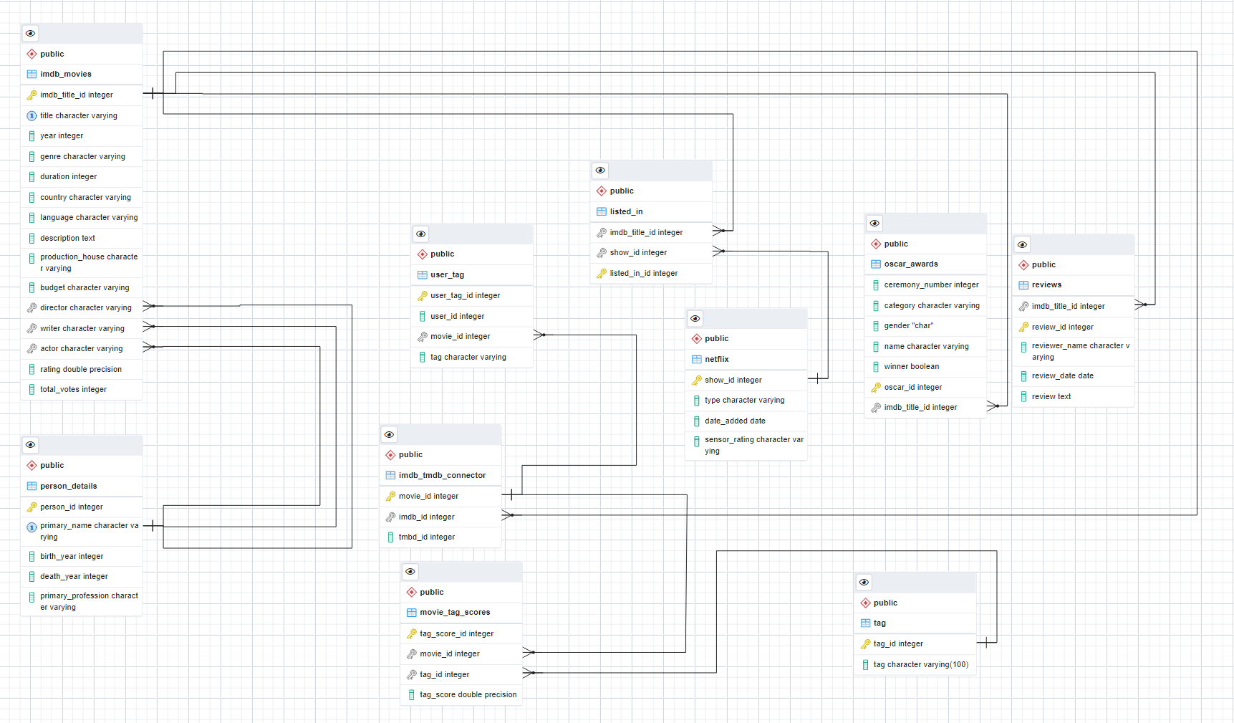

Slide 7
Number of Records of Each Table
Table Name | Number of rows of data
Imdb_movies | 85855
Imdb_tmdb_connector | 8562
Listed_in | 2688
Movie_tag_scores | 31000
Netflix | 7786
Oscar_awards | 8912
Person_details | 49045
Reviews | 50000
Tag | 1128
User_tag | 3479

Slide 8
QUERIES

Slide 9
Queries Rohith
Get the "Tag_scores“ and respective "Tags" for the film "First Night", sorted by "tag_scores" in descending order?
SELECT MTS.tag_score, T.tag
FROM imdb_movies IM, imdb_tmdb_connector ITC, movie_tag_scores MTS, tag T
WHERE IM.imdb_title_id = ITC.imdb_id
AND ITC.movie_id = MTS.movie_iD
AND MTS.tag_id = T.tag_id
AND IM.title = 'First Knight'
ORDER BY MTS.tag_score DESC;

Slide 10
Queries Rohtih
Select top 100 reviewed imdb movies by the users and list them in descending order.
SELECT IM.title, COUNT(R.review_id)
FROM imdb_movies IM, reviews R
WHERE IM.imdb_title_id = R.imdb_title_id
GROUP BY IM.imdb_title_id
ORDER BY COUNT(R.review_id) DESC
LIMIT 100;

Slide 11
Queries vinay
list the directors who have won more than 1 oscar and number of oscars they have won in from highest to lowest.
SELECT OA.name ,count(OA.oscar_id)
FROM oscar_awards OA
WHERE OA.category LIKE '%DIRECTING%' AND OA.winner = True
GROUP BY OA.name
HAVING count(OA.oscar_id) > 1
ORDER BY count(OA.oscar_id) DESC;

Slide 12
Queries vinay
Find the description of the top 10 movies which received tags from most users, show description , movie and number of users
SELECT im.title, im.description, COUNT( ut.user_tag_id)
FROM imdb_movies im ,imdb_tmdb_connector it,user_tag ut
WHERE im.imdb_title_id = it.imdb_id AND it.movie_id = ut.movie_id
GROUP BY im.imdb_title_id,im.description
ORDER BY count( ut.user_tag_id) desc
LIMIT 10;

Slide 13
Queries Bilvani
List the movies and the directors who won oscars in the year 2000
select im.title, im.director
from oscar_awards oa, imdb_movies im
where im.imdb_title_id = oa.imdb_title_id and oa.winner = true and im.year =2000
group by im.imdb_title_id

Slide 14
Queries
List top 10 rated movies that are streaming on netflix from year 2000 to 2010
select im.title, im.rating
from netflix n, imdb_movies im, listed_in l
where im.imdb_title_id = l.imdb_title_id and l.show_id = n.show_id and im.year
between 2000 and 2010
group by im.imdb_title_id
order by im.rating desc
limit 10

Slide 15
THANK YOU

